Slide 1
Azure Defender for IoT
300.2 Alert Handling

Slide 2
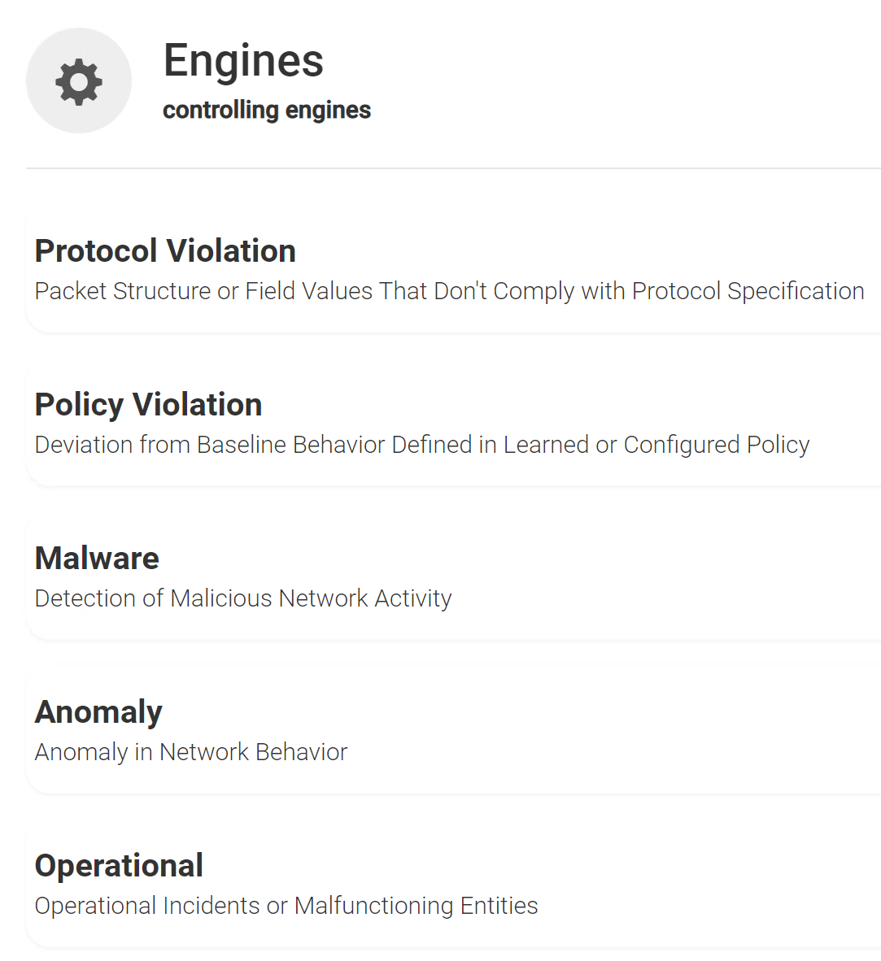
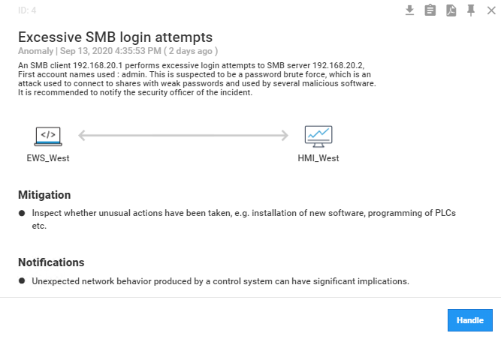
Alert Handling
Alert categories
Benefits
Add new assets / new communication to the baseline
Provide details about protocol and operational anomalies
Review suspected malware traffic
Identify malicious or unnecessary address and port scans

Slide 3
Thank you

